Slide 1
DYNAMICAL EVOLUTION OF THE SEINAJOKI ASTEROID FAMILY
Vladimir Đošović
Bojan Novaković
The sixth Symposium "Mathematics and Applications"
17. October2015
Faculty of Mathematics, University of Belgrade, Serbia

Slide 2
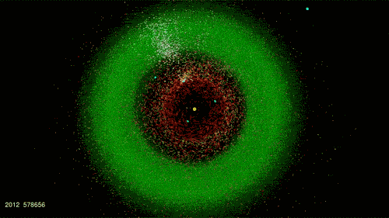
OUTLINE
What are asteroid families?
Why are they important?
Evolution of asteroid families
Aim of this work
Secular resonance with Ceres
Dynamical models
Results
Conclusions

Slide 3
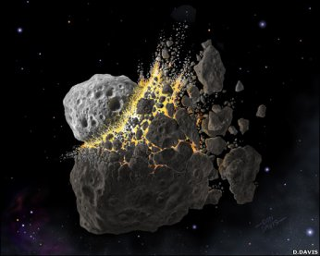
WHAT ARE ASTEROID FAMILIES?
An asteroid family is a population of asteroids that share similar orbital elements, such as semi-major axis, eccentricity, and inclination. These families are result of a collision among two asteroids.
Why fragments stay close to each other
after the collision?
How can we recognize asteroid families?

Slide 4
WHY ARE THAY IMPORTANT?
High energy collisions can not be simulated on Earth
Collisional evolution of main asteroid belt
Composition of the parent body
Families are connected with almost all areas of study of asteroids

Slide 5
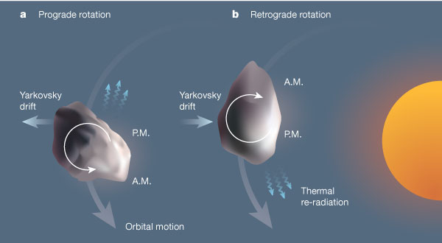
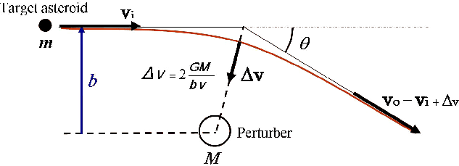
DYNAMICAL EVOLUTION OF ASTEROID FAMILIES
Evolution of orbital parameters
Gravitational effects
Non gravitational effects

Slide 6
AIM OF THIS WORK
Reconstruction of the complex shape of the Seinajoki asteroid family

Slide 7
(1521) SEINAJOKI FAMILY
Family is placed in the outer part of the main asteroid belt
Semi-major axis of the family is 2.83-2.9 AU, the orbital inclination of family is a comparatively high, about 15 degrees, with moderate eccentricity of 0.12
The inner edge of the family, in term of semi-major axis, is limited by the strong mean-motion resonance, that is 5:2 with Jupiter
Family consists of S type asteroids
The Seinajoki asteroid family is also known as Brasilia

Slide 10
SECULAR RESONANCE WITH CERES
Motivation for this work comes from recent results about secular resonance with Ceres
This resonance is found to cross Seinajoki family

Slide 11
DYNAMICAL MODELS
2 dynamical models are used for integrations
These dynamical models are without inner planets
Both models include Yarkovsky effect
Integrations time span is 200 Myr

Slide 12
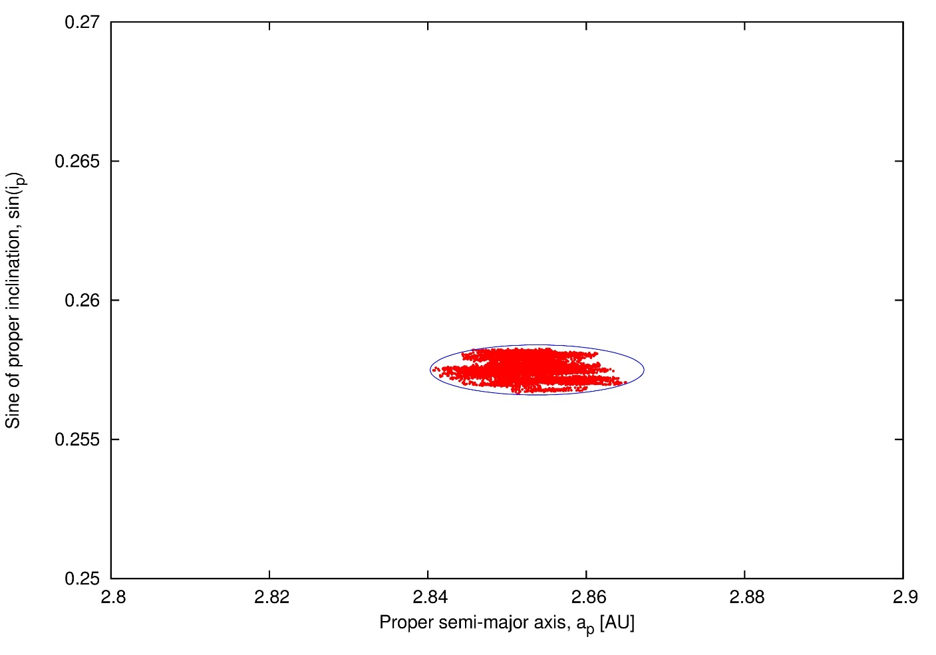
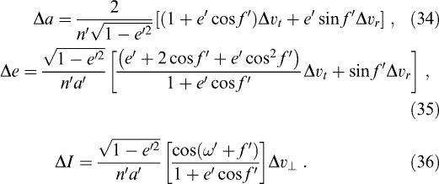
INITIAL CONDITIONS
Gauss's equation determines the initial ellipse
This ellipse denotes the maximum dispersion of fragments immediately after the collision

Slide 13
IMPLEMENTATION OF THE YARKOVSKY EFFECT
The Yarkovsky effect is inversely proportional to the diameter of an asteroid
Number of test particles corresponds to number of real family members
Size of test particles corresponds to size of real family members

Slide 14
RESULTS

Slide 16
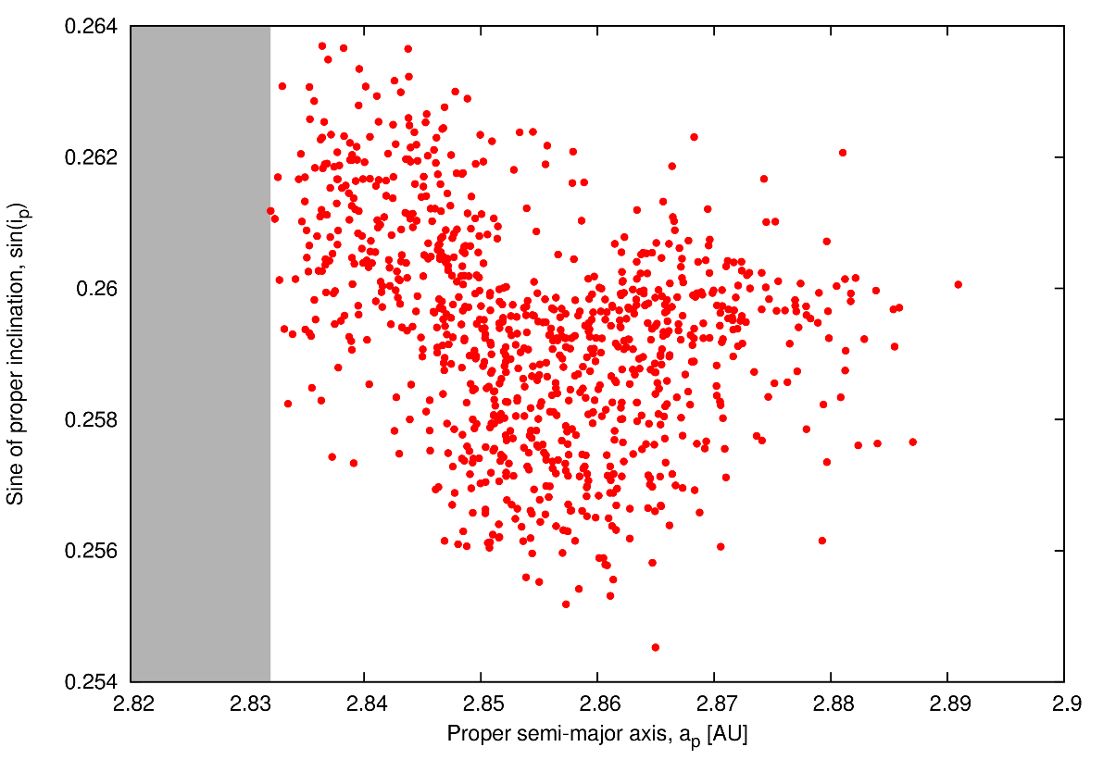
CONCLUSIONS
Ceres is very important for the evolution
The most important parts are explained
What is not explained?
Two initial families?
Role of inner planets?

